Slide 1
Abraham and Isaac
Genesis 22

Slide 2
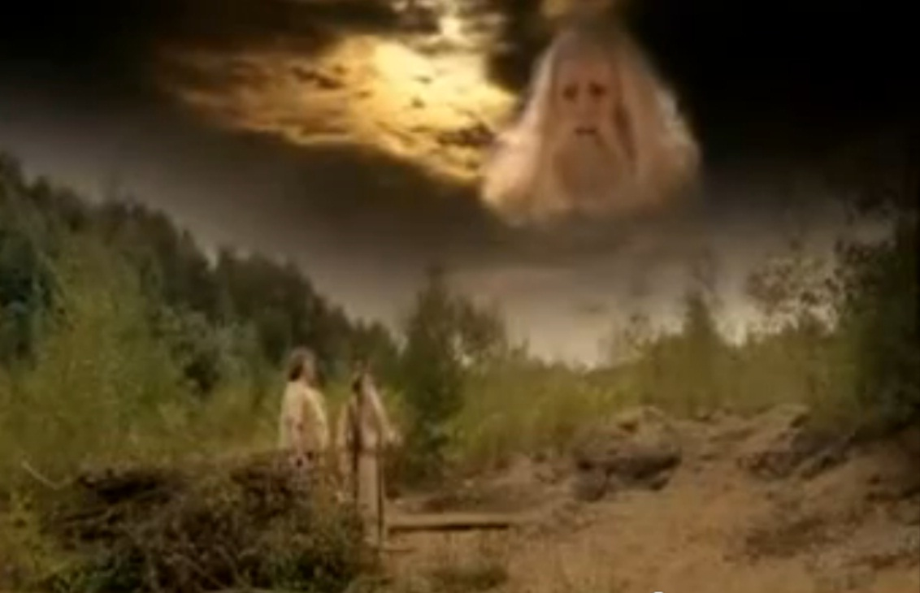
Abraham and Isaac
Mitchell and Webb, BBC TV

Slide 3
Genesis 22 – what is it all about?
Faith
Love

Slide 4
Hebrews 11
By faith Abraham, when God tested him, offered Isaac as a sacrifice. He who had embraced the promises was about to sacrifice his one and only son, even though God had said to him, “It is through Isaac that your offspring will be reckoned.” Abraham reasoned that God could even raise the dead, and so in a manner of speaking he did receive Isaac back from death.

Slide 5
Abraham’s Faith
Abraham had a complicated journey of faith to get to this point
  12:1-9 - God calls Abram
  12:10-17 - Abram in Egypt
  13:14-17 – God promises:
    “Look around from where you are, to the north and south, to the east and west. All the land that you see I will give to you and your offspring forever. I will make your offspring like the dust of the earth, so that if anyone could count the dust, then your offspring could be counted. Go, walk through the length and breadth of the land, for I am giving it to you.”
  15: 4-5 – God promises:
    Then the word of the LORD came to him: “This man will not be your heir, but a son who is your own flesh and blood will be your heir.” He took him outside and said, “Look up at the sky and count the stars—if indeed you can count them.” Then he said to him, “So shall your offspring be.”
    Abram believed the LORD, and he credited it to him as righteousness.
  16 – Hagar and Ishmael
  17 – Covenant of circumcision and renaming of Abraham and Sarah
  18 – 19, Three visitors and destruction of Sodom and Gomorrah
  20 – Abraham and Abimelek (It’s Egypt, all over again…!)
  21 – Birth of Isaac

Slide 6
Abraham’s Faith
v1 “Here I am”
v3 Early the next morning
v5 “we will come back to you”
v8 “God himself will provide the lamb”
v10 He reached out his hand to slay his son
v15-18 Abraham’s reward

Slide 7
For God so loved the world…
v2 Take your son, your only son, whom you love…
v8 “God himself will provide the lamb”
v4 on the third day…
Jesus is the Son of God
  but what does that mean?
  “What more could God have given,
  Tell me what more did He have to give?”

Slide 8
Gethsemene
John 17
Luke 22: 39-45
Mark 14: 32-42
Matthew 26: 36-45
Half a conversation…
For God so loved the world….

